Slide 1
DICE CHESS
Group 23
Night Watchers
Onur MERMER - Çağrı ORHAN – Fırat YILDIZ – Alshir SOYUNJOV

Slide 2
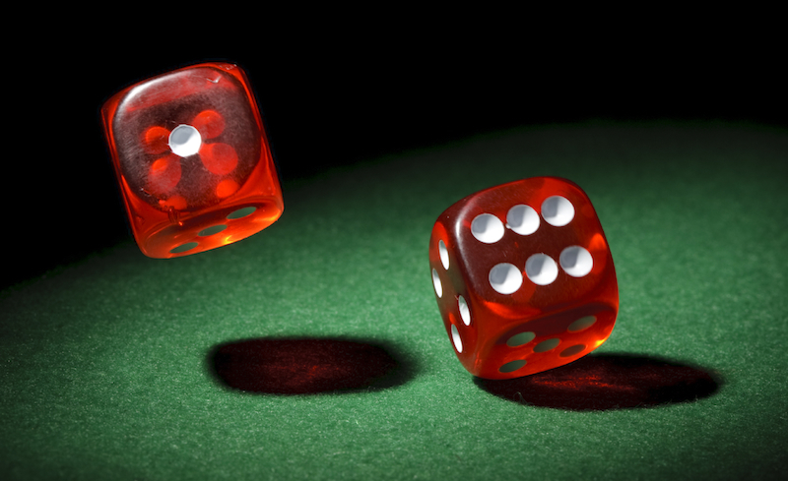
What is Dice Chess?
Dice Chess is a game which combines strategy and chance by adding dice to the classical chess game.

Slide 3
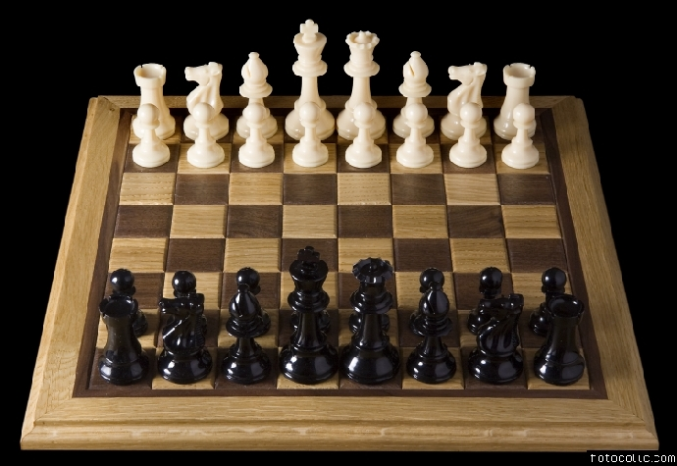
What we aimed?
Our purpose is to make chess enjoyable for beginners with extra features.

Slide 4
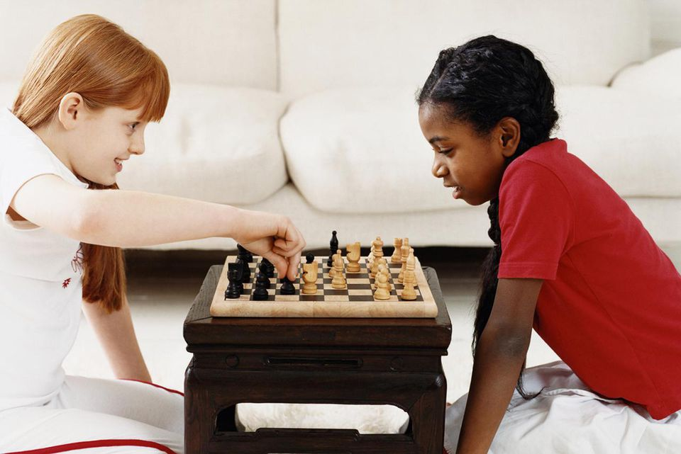
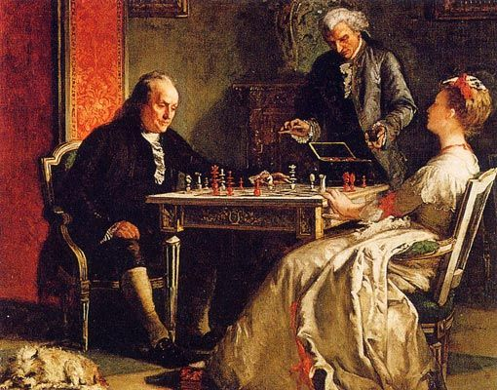
Our Target
Chess is a game that people have been playing for thousands years.
We are trying to introduce Dice Chess to people who play chess.
Our target is people who like chess or who wants to learn chess.

Slide 5
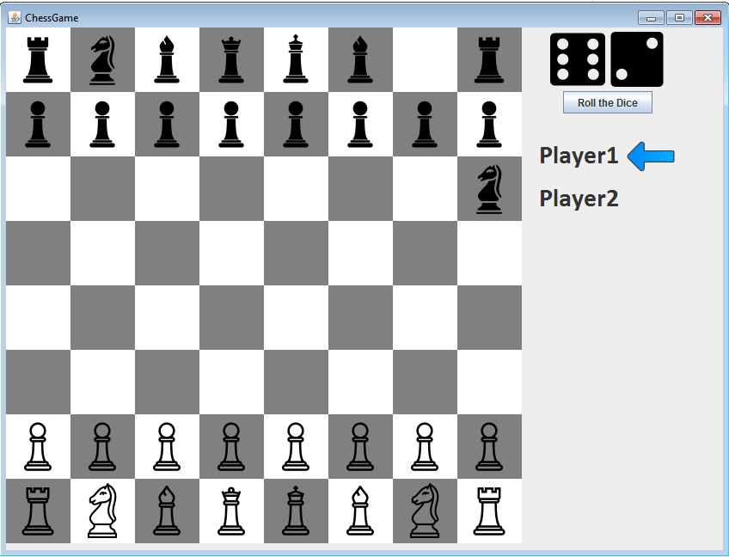
How to Play?

Slide 6
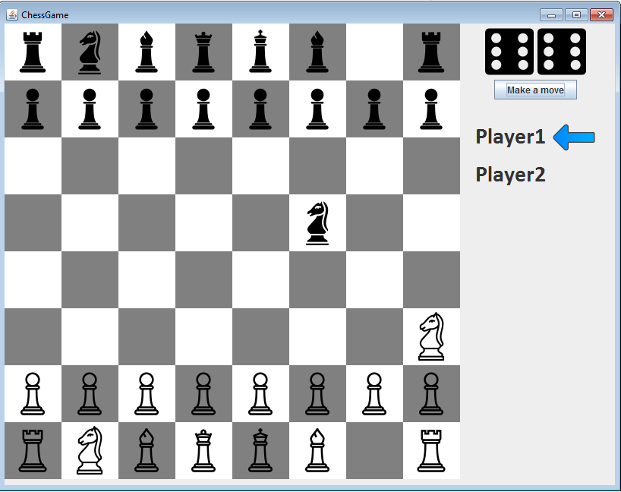
How to Play?

Slide 7
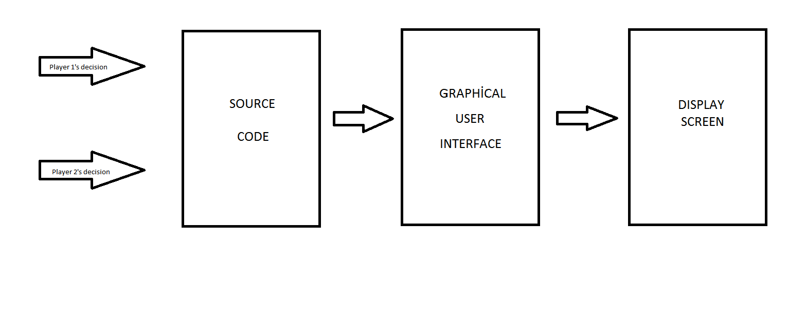
How it’s working?

Slide 8
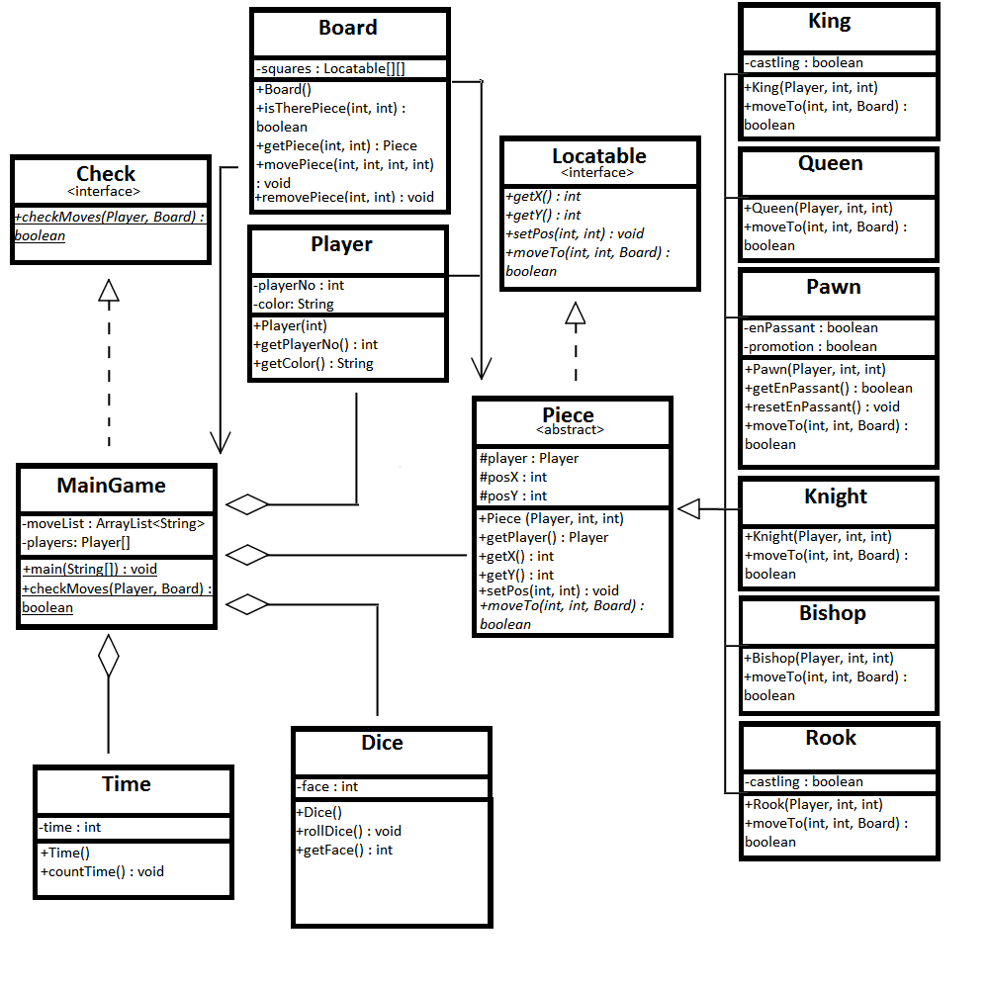
UML DIAGRAM

Slide 9
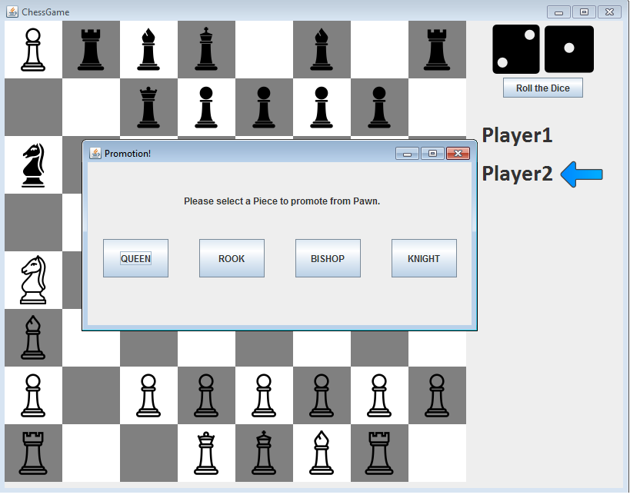
Some Chess Features
Promotion
EnPassant
Castling

Slide 10
Important Classes
Abstract Piece Class (Queen , Rook , Knight etc.)
Locatable Interface
Check Class
Dice Class
Board Class
MainGame Class

Slide 11
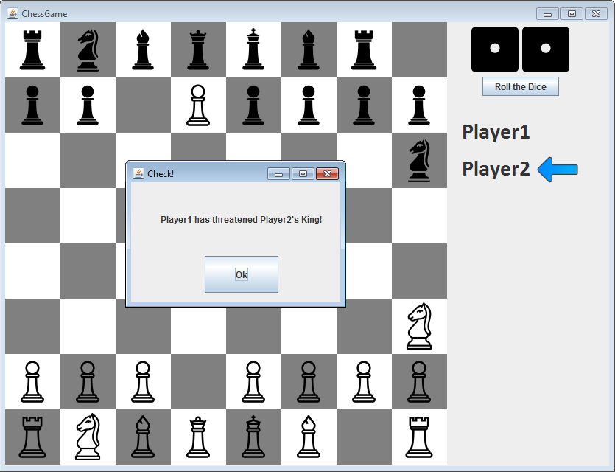
Important Methods
checkMoves() Method
createComponents() – Create pieces and put them to board and arrays
moveTo() Method – check the situations. If there is no obstacle, move piece to desired location. Update position and array position.

Slide 12
Work Partition between Group Members
Alshir Soyunjov – Knight, King,Check, GUI, Board
Çagrı Orhan – Queen, Bishop, Rook, GUI, Locatable
Onur Mermer – Player, Pawn, GUI, Main Game, Time
Fırat Yıldız – Dice, Player, GUI, Start Frame
Note: Moreover, some assistant classes were written as well as the classes explained above.

Slide 13
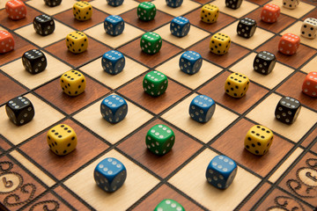
What did we expected?
We were expected to create a chess game which combines dice and classical chess game. It also includes timer in it.

Slide 14
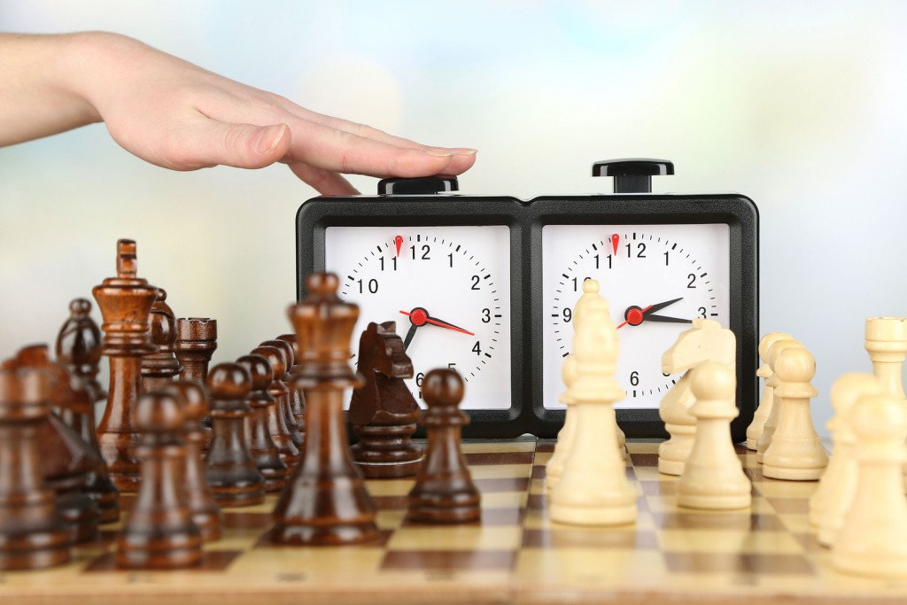
What remains for the future?
We managed to play the game with more efficiency. We left the timer to the future. Also some graphics details like 3D game left to future.

Slide 15
THANK YOU FOR YOUR ATTENTION !

